Slide 1
Arithmetic Operations
Mathematical Operators | Describe What is it? What is it for? | Explain/Example When would it be used?
+ | Addition | 1+1
- | Subtraction | 1-1
/ | Division | 4/2
DIV // | Finding the integer without the remainder through division | 7 div 2
* | Multiplication | 1*2
MOD % Modulo rem | Finding the remainder only | 7 mod 2
Relational Operators | Describe What is it? What is it for? | Explain/Example When would it be used?
== | Equal to | 1 == 1 ?
< | Smaller than | 2<4
<= | Smaller than or equal to | 2<=4
> | Bigger than | 2>1
>= | Bigger than or equal to | 2>=1
<> != | Not equal to | 1<>0
Boolean Operators | Describe What is it? What is it for? | Explain/Example When would it be used?
NOT ! | Inverses the value of the statement | !A = B
AND && | 2 conditional statements have to be correct for the output to be true | 1 && 1 = 1
OR || | if 1 or both statements are correct the output is true | 1 || 0 = 1

Slide 2
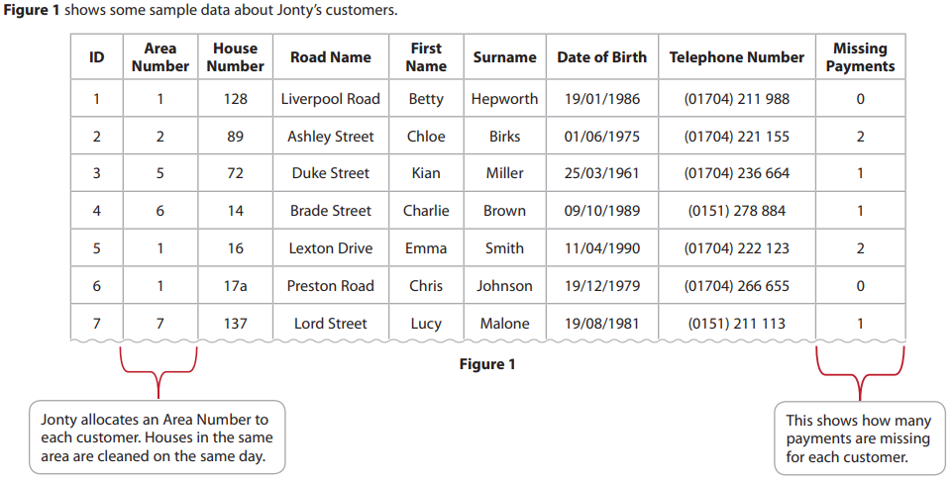
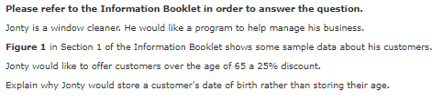
Bronze 1
Exam Questions
Write below [2 marks]

Slide 3
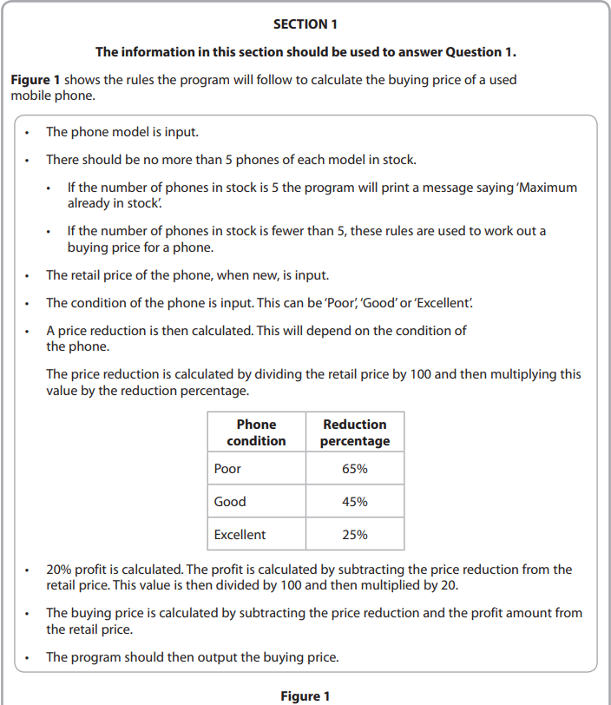
Bronze 2
Exam Questions

Slide 4
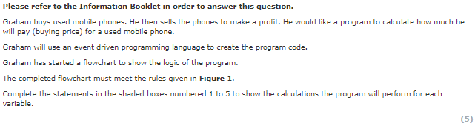
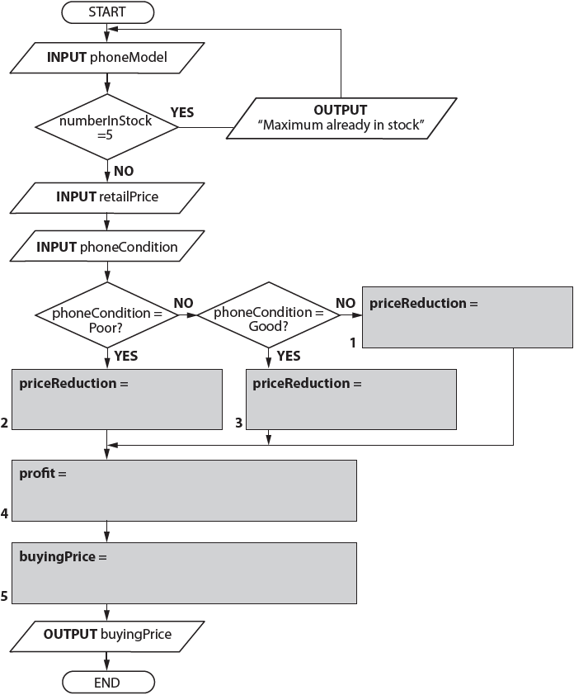
Bronze 2
Exam Questions

Slide 5
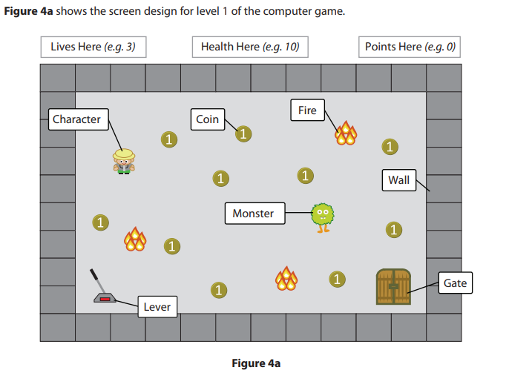
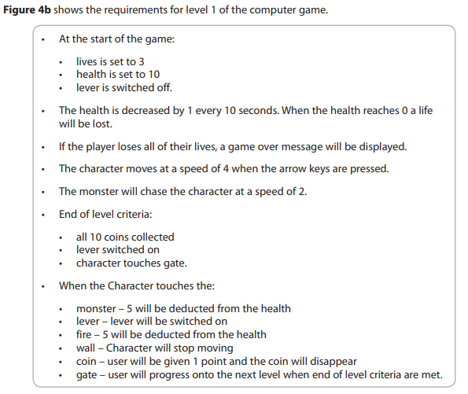
Silver 1
Exam Questions

Slide 6




Silver 1
Exam Questions
[6 marks]

Slide 7
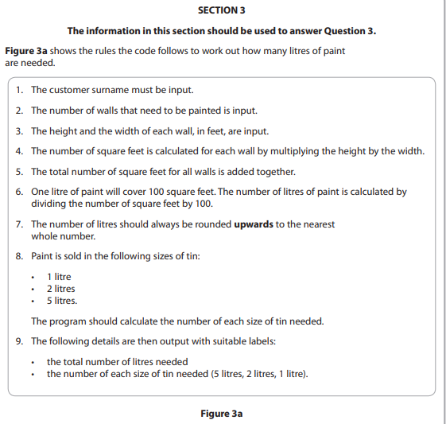
Gold 1
Exam Questions

Slide 8
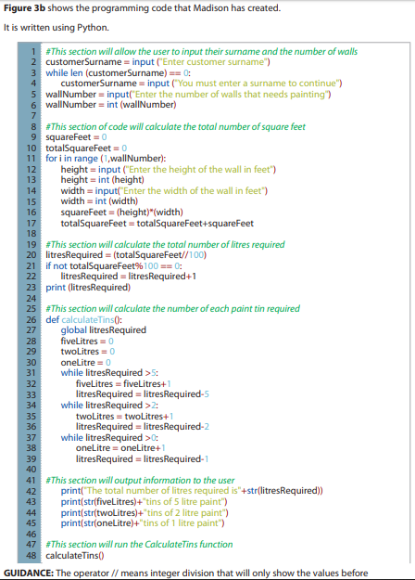
Gold 1
Exam Questions

Slide 9
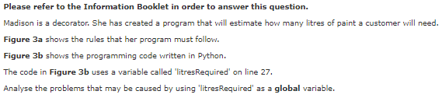
Gold 1
Exam Questions
Analyse below[6 marks]

